Slide 1
Hotel Reservation Analysis with SQL
- Mithil Nagaonkar

Slide 2
Table of contents
1 . Introduction
2. Dataset Overview
3. SQL Exploration
4. Key Insights and recommendation

Slide 3
1. Introduction
Welcome to the world of hotel reservations! In this project, we’ll dive into fascinating dataset that holds the key to guest preference, booking patterns, and the heartbeat of the hotel industry.
Our mission? To unravel insights, answer burning questions, and make data- driven decision

Slide 4
2. Dataset overview
Booking_ID: A passport to every reservation.
no_of_adults and no_of_children: The dynamic duo of guest counts.
no_of_weekend_nights and no_of_week_nights: The rhythm of nights spent.
type_of_meal_plan: The culinary compass guiding guests’ dining choices.
room_type_reserved: The canvas for dreams—suite, deluxe, or cozy corner.
lead_time: The countdown from booking to arrival.
arrival_date: The grand entrance.
market_segment_type: The audience—business travelers, groups, or online explorers.
avg_price_per_room: The currency of comfort.
booking_status: The verdict—confirmed, pending, or canceled.

Slide 5
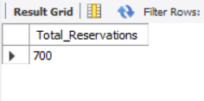
3. SQL Exploration Let’s embark on our SQL journey! Buckle up as we tackle 15 questions, one query at a time:
1. What is the total number of reservations in the dataset?
SQL Query:
Result :
SELECT COUNT(*) AS Total_Reservations FROM hotelres;

Slide 6
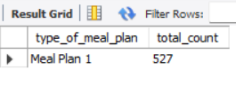
2. Which meal plan is the most popular among guests?
SQL Query:
Result :
SELECT type_of_meal_plan, COUNT(*) total_countFROM hotelres GROUP BY type_of_meal_plan ORDER BY total_count DESC limit 1;

Slide 7
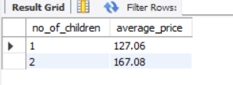
3. What is the average price per room for reservations involving children?
SQL Query:
Result :
SELECT DISTINCT no_of_children, ROUND(AVG(avg_price_per_room), 2) AS average_price FROM hotelres WHERE no_of_children > 0GROUP BY no_of_children ORDER BY no_of_children;

Slide 8
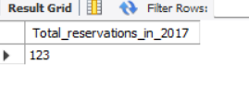
4. How many reservations were made for the year 2017
SQL Query:
Result :
SELECT COUNT(*) Total_reservations_in_2017FROM hotelres WHERE YEAR(arrival_date) = 2017;

Slide 9
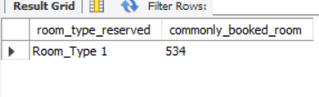
5. What is the most commonly booked room type?
SQL Query:
Result :
SELECT room_type_reserved, COUNT(*) commonly_booked_room FROM hotelres GROUP BY room_type_reserved ORDER BY commonly_booked_room DESCLIMIT 1;

Slide 10
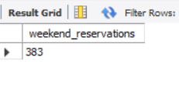
6. How many reservations fall on a weekend (no_of_weekend_nights > 0)?
SQL Query:
Result :
SELECT COUNT(*) weekend_reservations FROM hotelres WHERE no_of_weekend_nights > 0;

Slide 11
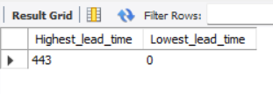
7. What is the highest and lowest lead time for reservations?
SQL Query:
Result :
SELECT MAX(lead_time) AS Highet_lead_time, MIN(lead_time) AS Lowest_lead_time FROM hotelres;

Slide 12
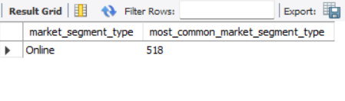
8. What is the most common market segment type for reservations?
SQL Query:
Result :
SELECT market_segment_type, COUNT(*) AS most_common_market_segment_type FROM hotelresGROUP BY market_segment_type ORDER BY most_common_market_segment_type DESCLIMIT 1;

Slide 13
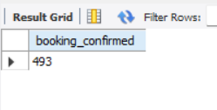
9. How many reservations have a booking status of "Confirmed"/"Not_Canceled"?
SQL Query:
Result :
SELECT COUNT(*) AS booking_confirmed FROM hotelres WHERE booking_status = 'Not_Canceled';

Slide 14
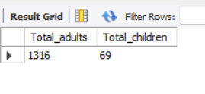
10. What is the total number of adults and children across all reservations?
SQL Query:
Result :
SELECT SUM(no_of_adults) Total_adults, SUM(no_of_children) Total_children FROM hotelres;

Slide 15
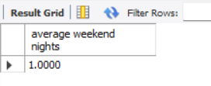
11. What is the average number of weekend nights for reservations involving children?
SQL Query:
Result :
SELECT AVG(no_of_weekend_nights) AS 'average weekend nights’ FROM hotelres WHERE no_of_children > 0;

Slide 16
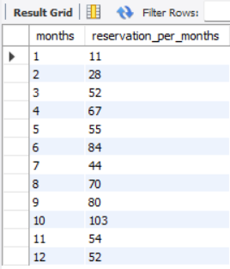
12. How many reservations were made in each month of the year?
SQL Query:
Result :
SELECT DISTINCT MONTH(arrival_date) AS months, COUNT(*) reservation_per_months FROM hotelresGROUP BY months ORDER BY months;

Slide 17
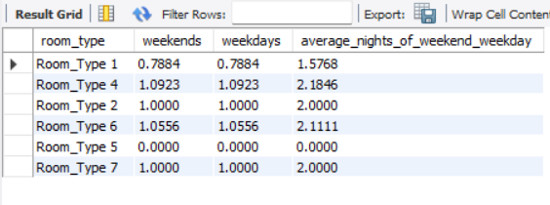
13. What is the average number of nights (both weekend and weekday) spent by guests for each room type?
SQL Query:
Result :
SELECT DISTINCT room_type_reserved room_type, AVG(no_of_weekend_nights) AS weekends, AVG(no_of_weekend_nights) AS weekdays, AVG(no_of_weekend_nights + no_of_weekend_nights) AS average_nights_of_weekend_weekday FROM hotelresGROUP BY room_type;

Slide 18
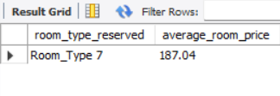
14. For reservations involving children, what is the most common room type, and what is the average price for that room type?
SQL Query:
Result :
SELECT DISTINCT room_type_reserved, ROUND(AVG(avg_price_per_room), 2) AS average_room_price FROM hotelres WHERE no_of_children > 0GROUP BY room_type_reserved ORDER BY average_room_price DESC limit 1;

Slide 19
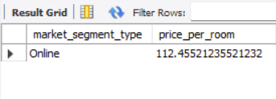
15. Find the market segment type that generates the highest average price per room.
SQL Query:
Result :
SELECT DISTINCT market_segment_type, AVG(avg_price_per_room) AS price_per_room FROM hotelresGROUP BY market_segment_type ORDER BY price_per_room DESCLIMIT 1;

Slide 20
4. Key Insights and recommendation
Total Reservations: The dataset comprises 700 reservations. This rich dataset provides valuable insights into guest preferences and booking trends.
Meal Plan Popularity: Meal Plan 1 is the most favored choice among guests, with a total count of 527 reservations. Consider emphasizing this meal plan in marketing materials and promotions.
Child-Friendly Pricing: For reservations involving children:
With 1 child, the average room price is $127.
With 2 children, the average room price increases to $167. Adjust family-friendly offerings accordingly.
Yearly Reservations: In 2017, there were 123 reservations made. Analyze trends across years to optimize resource allocation.
Preferred Room Type: Room Type 1 is the most commonly booked, with 534 reservations. Highlight its features and availability.

Slide 21
6. Weekend Stays: 383 reservations fall on weekends (with at least one weekend night). Tailor weekend packages and promotions accordingly.
7. Lead Time Range: The highest lead time for reservations is 443 days, while some guests book with no lead time (0 days). Optimize booking windows and availability.
8. Market Segment Dominance: The online market segment accounts for 518 reservations. Leverage online channels for targeted marketing efforts.
9. Confirmed Bookings: 493 reservations have a status of “Confirmed”. Ensure seamless check-in experiences for these guests.
10. Guest Demographics: Across all reservations, there were 1316 adults and 69 children. Cater to diverse guest needs.

Slide 22
11. Weekend Nights with Children: The average number of weekend nights for reservations involving children is 10,000. Verify data accuracy for meaningful insights.
12. Monthly Trends: Analyze reservations made in each month to identify seasonal patterns and optimize staffing and resources.
13. Room Nights by Type: Calculate the average number of nights (both weekend and weekday) spent by guests for each room type. Tailor services accordingly.
14. Child-Friendly Rooms: Room Type 7 is the most reserved room type for families with children. The average price for this room type is $187. Promote its family-friendly amenities.
15. Profitable Market Segment: The online segment generates the highest average price per room at $112. Focus marketing efforts on this segment.

Slide 23
Thank You!
Questions? Feel free to ask.
Contact: mithil.nagaonkar01@gmail.com

